Slide 1
Social Media Analytics
Topic 1: Introduction to Social Media Analytics

Slide 2
Learning Objectives
What is social media analytics?
Challenges of social media analytics
Three types of media

Slide 3
Understanding the basics of Social Media analytics

Slide 4
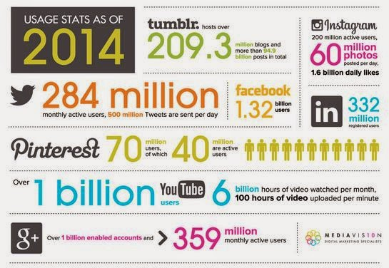
2014 Social Media Statistics
Source: Infographic Digital

Slide 5
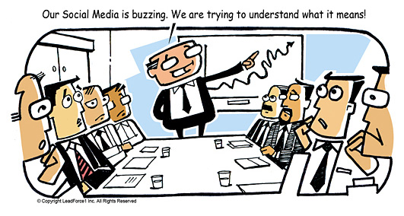
SO WHAT?
Source: Leadformix.com

Slide 6
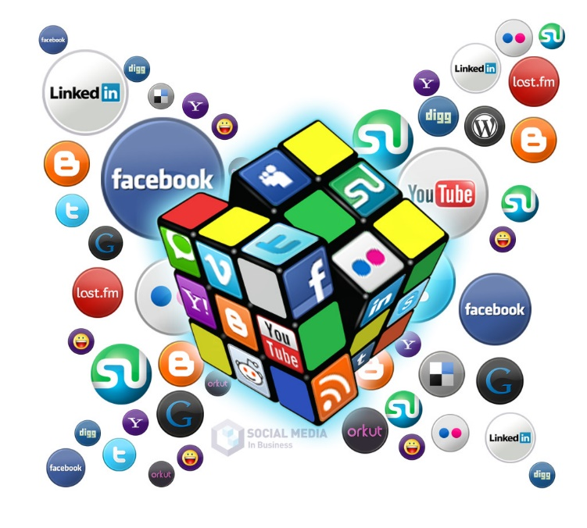
What is Social Media Analytics?
Social media analytics (SMA) refers to the approach of collecting data from social media sites and blogs and evaluating that data to make business decisions.
This process goes beyond the usual monitoring or a basic analysis of retweets or "likes" to develop an in-depth idea of the social consumer.
Source: Technopedia.com

Slide 7

What is Social Media Analytics?

Slide 8

Challenges
How to quantify relationships, communities, influence and engagement?
Source: Taming the social media beast

Slide 9
Challenges
How to stay focused on the meaningful metrics and ignore the noises –
In the midst of hoopla, skepticism and impatience
Source: Taming the social media beast

Slide 10
Challenges
How to find out what’s working and what’s not –
So that you can refine and analyse.
Source: Taming the social media beast

Slide 11
Challenges
How to set expectations
Source: Taming the social media beast

Slide 12
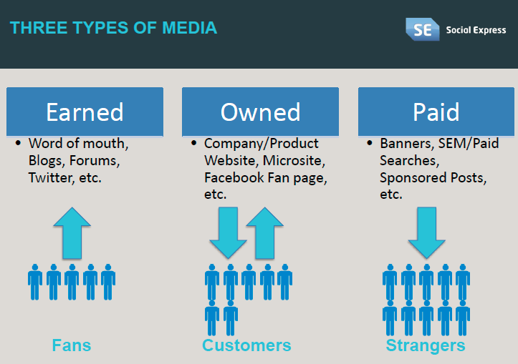
Three types of media

Slide 13
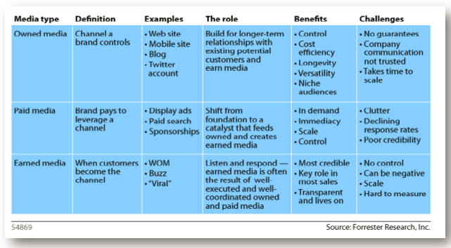
Three types of media

Slide 14
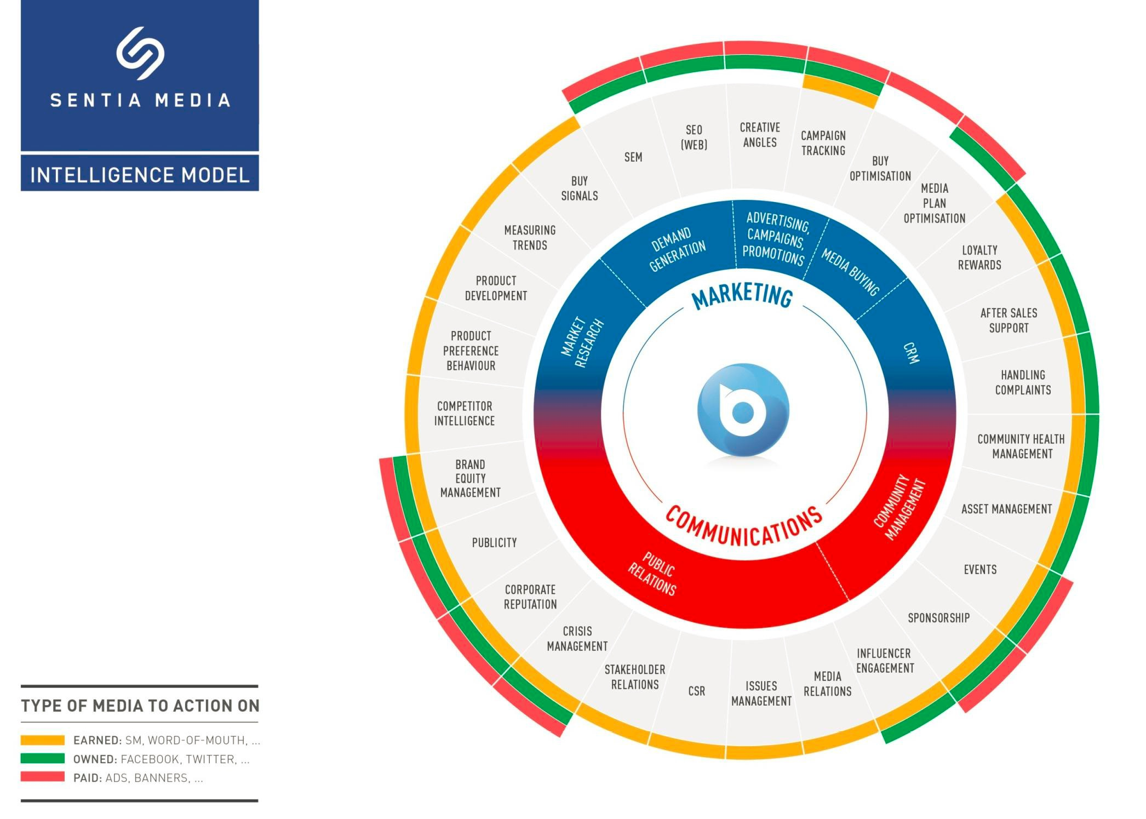
Three types of media

